Slide 1

Real Time Voice Cloning Using Neural Fusion

Slide 2
REAL TIME VOICE CLONING USING NEURAL FUSION
Batch No:B3
TEAM MEMBERS :
NAME | REGISTER NUMBER
AKSHAY SREE KRISHNA M | 211520104010
APPRAJIT VAIBHAV M | 211520104014
JOHN KELWIN JK | 211520104069
SRIRAM CM | 211520104156
GUIDE :
Mrs. TAMILSELVI,
Assistant Professor,
Department of CSE,
Panimalar Institute of Technology.

Slide 3
BASE PAPER
TITLE : Unsupervised TTS Acoustic Modeling for TTS With
Conditional Disentangled Sequential VAE
AUTHOR : Jiachen Lian, Chunlei Zhang , Gopala K.
Anumanchipalli and Dong Yu
DOMAIN : NATURAL LANGUAGE PROCESSING
YEAR : 2023

Slide 4
OBJECTIVES
The main objective of the REAL TIME VOICE CLONNING USING NEURAL FUSION is to clone voice in real time
Some specific objectives of this system are:
To reduce the amount of input voice data,
To reduce the training time of the system.

Slide 5
INTRODUCTION
The goal of this work is to build a TTS system which can generate natural speech for a variety of speakers in a data efficient manner. We specifically address a zero-shot learning setting, where a few seconds of untranscribed reference audio from a target speaker is used to synthesize new speech in that speaker’s voice, without updating any model parameters. Such systems have accessibility applications, such as restoring the ability to communicate naturally to users who have lost their voice and are therefore unable to provide many new training examples. They could also enable new applications, such as transferring a voice across languages for more natural speech-to-speech translation, or generating realistic speech from text in low resource settings. However, it is also important to note the potential for misuse of this technology, for example impersonating someone’s voice without their consent. In order to address safety concerns consistent with principles such as [1], we verify that voices generated by the proposed model can easily be distinguished from real voices. Synthesizing natural speech requires training on a large number of high quality speech-transcript pairs, and supporting many speakers usually uses tens of minutes of training data per speaker [8]. Recording a large amount of high quality data for many speakers is impractical. Our approach is to decouple speaker modeling from speech synthesis by independently training a speaker-discriminative embedding network that captures the space of speaker characteristics and training a high quality TTS .

Slide 6
ABSTRACT
A neural network-based system for text-to-speech (TTS) synthesis is outlined, demonstrating its capacity to generate speech audio in the voices of various speakers, including those not observed during training. This project comprises three independently trained components. A speaker encoder network, which undergoes training on a speaker verification task utilizing a dataset of noisy speech from thousands of speakers without transcripts. This network generates a fixed-dimensional embedding vector based on only a few seconds of reference speech from a target speaker.A sequence-to-sequence synthesis network, based on Tacotron 2, produces a mel spectrogram from input text, conditioned on the speaker embedding derived from the speaker encoder.An auto-regressive WaveNet-based vocoder network converts the mel spectrogram into time-domain waveform samples.The model effectively transfers knowledge of speaker variability learned by the discriminatively-trained speaker encoder to the multispeaker TTS task, enabling the synthesis of natural speech from speakers not encountered during training. Emphasis is placed on the importance of training the speaker encoder on a diverse and extensive speaker set to achieve optimal generalization performance. Furthermore, it is demonstrated that randomly sampled speaker embeddings can be employed to synthesize speech in the voices of novel speakers dissimilar to those encountered during training, highlighting the model's ability to learn a high-quality speaker representation.

Slide 7
EXISTING SYSTEM
The Existing system is an TTS(Text To Speech) application which cant convert the text into speech, the voice used by the system is a huge data which will be trained to get desired out put.
The existing system do not clone voices the system will use the voice data trained by the developer and training takes significant amount of time and dat.
It uses VAE(Variational Auto Encoder).

Slide 8
DISADVANTAGE OF EXISTING METHOD
Take more time to train.
Voice break is unavoidable in VAE Encoder.
Need more input to train voice.
It will be difficult for the user to clone voices.

Slide 9
PROPOSED METHOD
We have designed a system that can take less amount of voice data for input and clone the voice to use it in a TTS(Text-To-Speech) application.
The user can directly record their desired voice to cloned or can use the pre recorded voice data.
The proposed system uses GE2E (Generalized End to End) Encoder.
The proposed system uses Tacotron (Synthesizer).

Slide 10
ADVANTAGES OF PROPOSED METHOD
The proposed system clone voice in real time.
It need less sample voice data as input than existing system.
Voice breaks are reduced .

Slide 11
APPLICATION
This application can clone voice of any person in real time if the sample voice is given as input.
It can record the minimum 5second voice or user ,clone it and use the voice in TTS application
Once the voice is cloned the user can enter the text in the text box and text shall be converted in to speech and recorded by the application the recorded speech can be saved in the desired folder by the user

Slide 12
BLOCK DIAGRAM
Speaker
Speaker
Encoder
Phoneme
sequence
Synthesizer
Vocoder
Wave form
Synthesizer :
Phoneme
sequence
Encoder
concat
Attention
Decoder
log- mel spectrogram

Slide 13
SOFTWARE REQURIEMENT
Operating System :windows 10 & 11
Language : PYTHON
IDE : MICROSOFT ‘S VISUAL STUDIO CODE
Libraries : Tkinder(GUI)
Framework : PyTorch
Package Manager : PIP
Dependencies : FFmpeg

Slide 14
HARDWARE REQUIREMENT
CPU : Intel Core i5 @ 2.5GHz
RAM : 4GB OR above
GPU : 2GB OR above
Audio : Microphone and headphone
Display : 720p Monitor or above

Slide 15
MODULES
The system consists of several modules and those modules and given below,
Speaker Encoder,
Synthesizer,
Vocoder,
Speaker Encoder:
The speaker encoder component produces a unique embedding vector for a given speaker utterance. The speaker encoder is usually trained separately from the rest of the TTS model as a speaker recognition/classification task.
Synthesizer:
Synthesizers typically create sounds by generating waveforms. It produces artificial human voice and the synthesizer consist of encoder, concat, attention and decoder. The waveform(mel spectrum) of the synthesized voice also generated by the system.
Vocoder :
The word vocoder is an abbreviation for voice encoder. A vocoder analyzes and transfers the sonic character of the audio signal arriving at its analysis input to the synthesizer sound generators. The result of this process is heard at the output of the vocoder. Typically, a vocoder is used after a TTS model that converts an input text into a spectrogram.

Slide 16
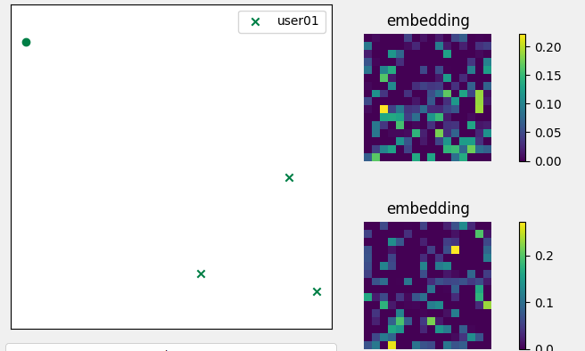
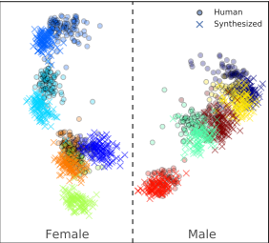
Embedding
Embeddings are representations of values or objects like text, images, and audio that are designed to be consumed by machine learning models and semantic search algorithms

Slide 17
LITERATURE SURVEY
TITLE | ISSUED | ADVANTAGE | DISADVANTAGE
1) efficiency TTS 2: variational end to end text to speech synthesis and voice conversation | IEEE international conference on signal process., Oct 2018 | The modal outperform baseline models in both single speaker and multi speaker. High MOS scores | The text does not explicitly mention any disadvantages or limitations of EFTS2.
(2) Depressive Tendency Recognition by Fusing Speech and Text Features: A Comparative Analysis | IEEE Transaction on Information Forensics and Security, vol. 3, No. 4, DECEMBER 2021 | The multimodal that fuses speech and text features shows better prediction of depression tendency | Using speech or text features alone may not be through in prediction depression as understanding text content or speech information alone may not fully capture individuals.

Slide 18
TITLE | ISSUED | ADVANTAGE | DISADVANTAGE
3) SPEECH BERT EMBEDDING FOR IMPROVING PROSODY IN NEURAL TTS | IEEE international conference on signal process., Oct 2017 | Effectively improves prosody in speech synthesis by dynamically extracting and incorporation prosody attributes | This paper does not provide any disadvantage or limitation of the system.
4) a machine speech chain approach for dynamically adaptive lombard tts in static and dynamic noise environments | IEEE Transaction on Information Forensics and Security, vol. 3, No. 4, DECEMBER 2020 | Dynamically adaptive lombard text to speech system Short term objective intensity Machine speech chain approach | System performance in dynamic noise condition is not effective Non-incremental TTS performed better in clean and static noise conditons

Slide 19
TITLE | ISSUED | ADVANTAGE | DISADVANTAGE
5) TTS-BY-TTS: TTS-DRIVEN DATA AUGMENTATION FOR FAST AND HIGH-QUALITY SPEECH SYNTHESIS | IEEE international conference on signal process., Oct 2008 | Improves the quality of non-autoregressive text to speech system . Limited training data. | Generating large-scale synthetic corpora with phoneme durations using an auto regressive TTS system may require significant computational resources.
6) Neural Fusion for Voice Cloning | IEEE Transaction on Information Forensics and Security, vol. 3, No. 4, DECEMBER 2008 | Enhances speakers similarity. Maintains speech naturalness in voice cloning application. | The system may still face challenges with concatenation gaps despite the proposed refinement strategies.

Slide 20
TITLE | ISSUED | ADVANTAGE | DISADVANTAGE
7) Expressive tts training with frame and style reconstruction loss | IEEE international conference on signal process., Oct 2008 | Model with frame and structural reconstruction loss. Use of low deep style features is effective | Paper does not explicitly mention disadvantages of proposed training strategy or model.
8) A Semi-Automatic Method for Transcription Error Correction for Indian Language TTS Systems | IEEE Transaction on Information Forensics and Security, vol. 3, No. 4, DECEMBER 2008 | Improved network efficiency through optimized communication protocols | Increased complexity and potential errors in network architectures.

Slide 21
TITLE | ISSUED | ADVANTAGE | DISADVANTAGE
9) Decoding knowledge transfer for neural text to speech training | IEEE international conference on signal process., Oct 2014 | Effective knowledge transfer Neural TTS with naturalness and robustness | Complex Training process Limited run time efficiency Need for pre-trained models
10) Speech synthesis with mixed emotions | IEEE Transaction on Information Forensics and Security, vol. 3, No. 4, DECEMBER 2020 | This study allows for the mixed emotions in speech. Providing control and manipulation of emotion expression. | Conducting experiment with more emotional combinations are needed. Limitation in the enhancement of voice.

Slide 22
CONCLUSION
In conclusion, real-time voice cloning with neural fusion represents a significant advancement in human-computer interaction technology. By leveraging neural fusion algorithms, this technology offers the potential to create highly realistic and personalized synthesized voices in real-time applications. With ongoing research and development, we can anticipate further improvements in naturalness, performance, and ethical considerations, paving the way for more immersive and engaging user experiences across diverse domains.

Slide 23
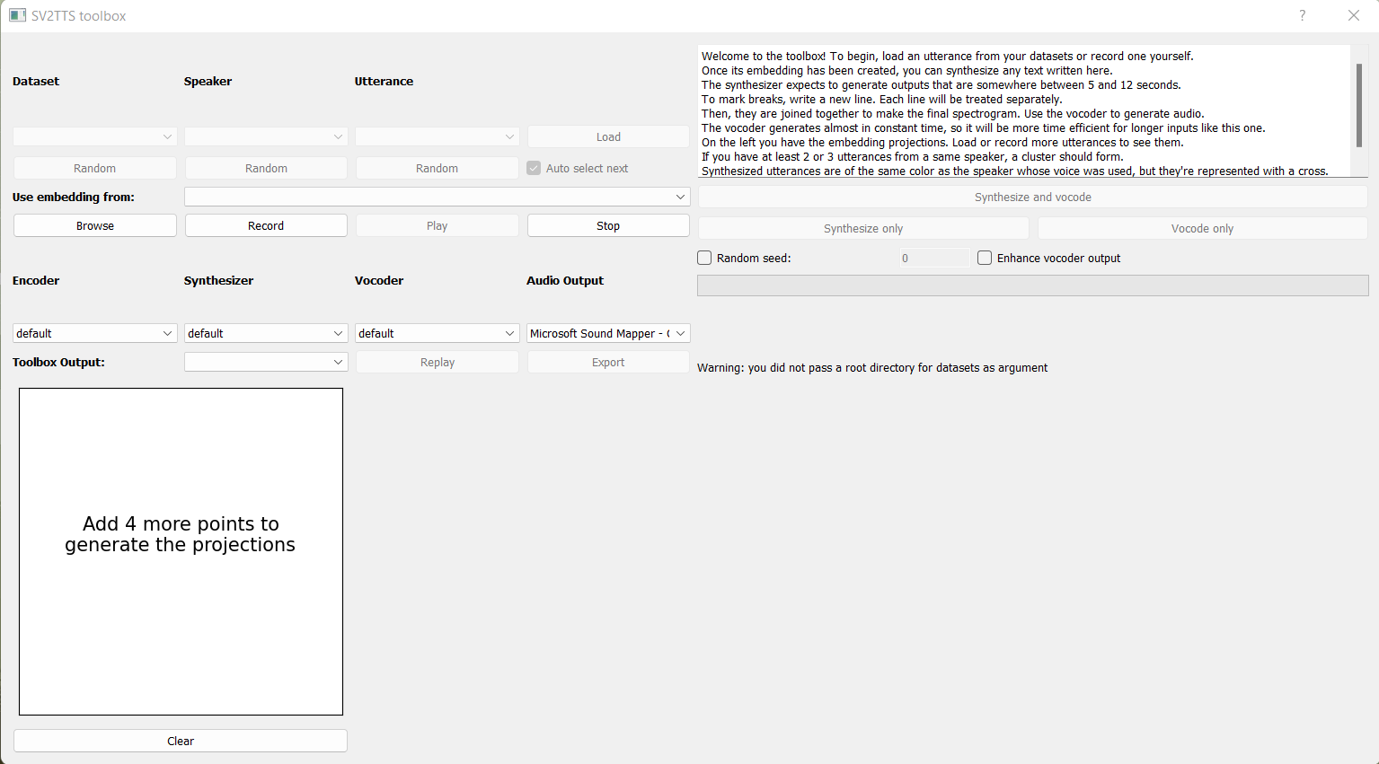
SCREENSHOT
Fig :Toolbox before cloning

Slide 24

Fig :Toolbox after cloning

Slide 25
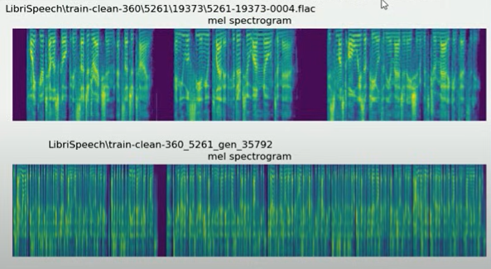
Fig : Mel Spectum

Slide 26
REFERENCES
[1] Artificial Intelligence at Google – Our Principles. https://ai.google/principles/, 2018.
[2] Sercan O Arik, Jitong Chen, Kainan Peng, Wei Ping, and Yanqi Zhou. Neural voice cloning with a few samples. arXiv preprint arXiv:1802.06006, 2018.
[3] Dzmitry Bahdanau, Kyunghyun Cho, and Yoshua Bengio. Neural machine translation by jointly learning to align and translate. In Proceedings of ICLR, 2015.
[4] Steven Boll. Suppression of acoustic noise in speech using spectral subtraction. IEEE Transactions on Acoustics, Speech, and Signal Processing, 27(2):113–120, 1979.
[5] Yutian Chen, Yannis Assael, Brendan Shillingford, David Budden, Scott Reed, Heiga Zen, Quan Wang, Luis C Cobo, Andrew Trask, Ben Laurie, et al. Sample efficient adaptive text-to-speech. arXiv preprint arXiv:1809.10460, 2018.

Slide 27
[6] Joon Son Chung, Arsha Nagrani, and Andrew Zisserman. VoxCeleb2: Deep speaker recognition. In Interspeech, pages 1086–1090, 2018.
[7] Rama Doddipatla, Norbert Braunschweiler, and Ranniery Maia. Speaker adaptation in dnnbased speech synthesis using d-vectors. In Proc. Interspeech, pages 3404–3408, 2017.
[8] Andrew Gibiansky, Sercan Arik, Gregory Diamos, John Miller, Kainan Peng, Wei Ping, Jonathan Raiman, and Yanqi Zhou. Deep Voice 2: Multi-speaker neural text-to-speech. In I. Guyon, U. V. Luxburg, S. Bengio, H. Wallach, R. Fergus, S. Vishwanathan, and R. Garnett, editors, Advances in Neural Information Processing Systems 30, pages 2962–2970. Curran Associates, Inc., 2017.
[9] Georg Heigold, Ignacio Moreno, Samy Bengio, and Noam Shazeer. End-to-end text-dependent speaker verification. In Acoustics, Speech and Signal Processing (ICASSP), 2016 IEEE International Conference on, pages 5115–5119. IEEE, 2016.
[10] Eliya Nachmani, Adam Polyak, Yaniv Taigman, and Lior Wolf. Fitting new speakers based on a short untranscribed sample. arXiv preprint arXiv:1802.06984, 2018.

